Slide 1
ESCAP / WMO TYPHOON COMMITTEE 16TH INTEGRATED WORKSHOP
VIRTUAL DECEMBER 2 – 3, 2021
IMPACT-BASED DECISION SUPPORT SERVICES (IDSS) AND THE U.S. NATIONAL WEATHER SERVICE (NWS)
Marcus Landon Aydlett
Warning Coordination Meteorologist
U.S. National Weather Service, Guam, U.S.A.
Marcus.Aydlett@NOAA.gov
STRENGTHENING IMPACT-BASED FORECASTING FOR IMPROVING THE CAPACITY OF TYPHOON-RELATED DISASTER RISK REDUCTION

Slide 2


Impact-Based Decision Support Services: Defined
What Is “Impact-Based Decision Support Services?”
IDSS is the provision of relevant information and interpretative services to enable Core Partners’ decisions when weather, water or climate has a direct impact on the protection of lives and livelihoods
IDSS AND THE U.S. NATIONAL WEATHER SERVICE

Slide 3
Importance of IDSS within the NWS
NWS Mission Statement
Provide weather, water and climate data, forecasts, warnings, and impact-based decision support services for the protection of life and property and enhancement of the national economy
The NWS Mission Statement was updated in October 2021 for the addition of “impact-based decision support services.”
IDSS AND THE U.S. NATIONAL WEATHER SERVICE

Slide 4
Importance of IDSS within the NWS
Dr. Louis Uccellini, Director, U.S. National Weather Service
On recognizing IDSS in the NWS Mission Statement:
“IDSS is now as much a part of our mission as forecasts and warnings, and reflects the realization that IDSS is actually an essential element for realizing the second half of the existing mission statement related to the protection of life and property.”
“By updating our mission, we acknowledge that to keep Americans safe and to enhance the economy, we must look beyond the forecast to transform the way people receive, understand, and act on information.”
IDSS AND THE U.S. NATIONAL WEATHER SERVICE

Slide 5
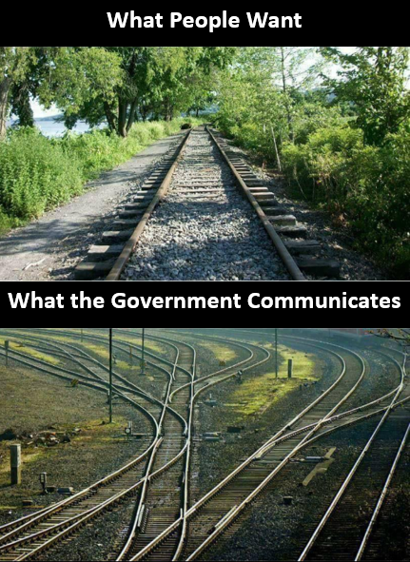
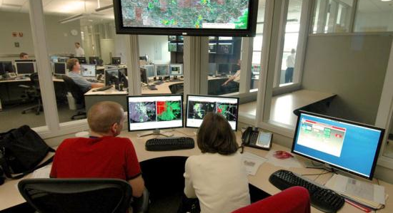

Why IDSS? A Vision for a Weather-Ready Nation
Mission for Today
Vision for Tomorrow
What We Communicate
Provide weather, water, and seasonal data, forecasts, warnings and Impact-Based Decision Support Services for the protection of life and property and the enhancement of the national economy
A Weather-Ready Nation where society is prepared for and responds to weather and water events; where communities are “Ready, Responsive and Resilient”
IDSS AND THE U.S. NATIONAL WEATHER SERVICE

Slide 6
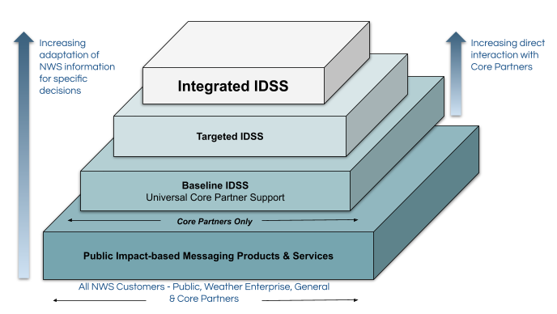
IDSS Strategy within the NWS
Continuum of Impact-based Messaging Services
Tiers of Products and Services
Public IDSS Messaging: The starting point of IDSS
Baseline IDSS: Services common to all core partners
Targeted IDSS: Services focused on a specific or group of core partners
Integrated IDSS: Dedicated support to core partner(s)
IDSS AND THE U.S. NATIONAL WEATHER SERVICE

Slide 7
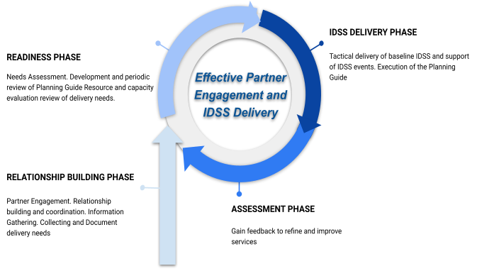
IDSS Strategy within the NWS
IDSS Operating Cycle
4 Phases of the Operating Cycle
Relationship Building
  Coordination with core partners on needs
Readiness
  NWS Office planning activities to meet partner needs and ensuring staff readiness (training and exercises)
Delivery
  Activities for the tactical delivery of IDSS based on planning and partner needs
Assessment
  Gathering feedback to refine and improve services to partners
IDSS AND THE U.S. NATIONAL WEATHER SERVICE

Slide 8
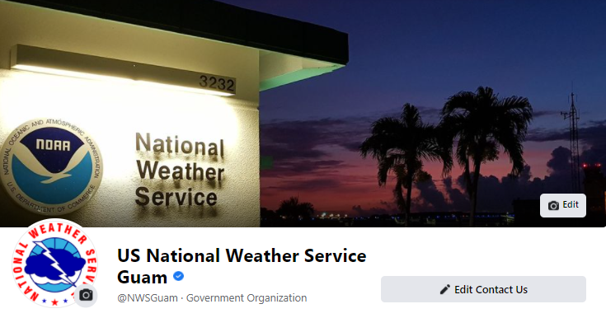
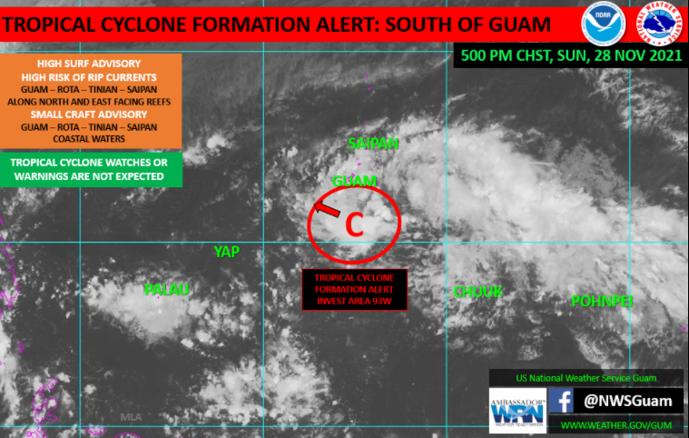
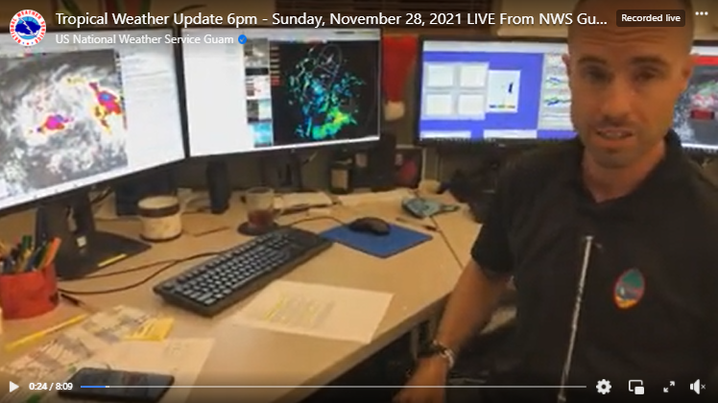
Operational IDSS: Social Media
Text is plain language
Easy to read/understand
Tells the reader what they want to know
Use of info-graphic
When to expect new information
Where to go for more information
IDSS AND THE U.S. NATIONAL WEATHER SERVICE

Slide 9
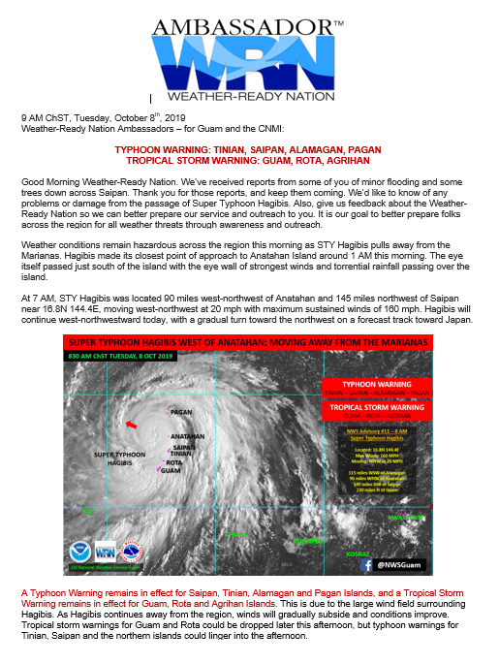
Operational IDSS: Weather-Ready Nation Emails
When facing a weather threat, people want to know what that threat is, what it means to them, and when.
This tangible item of the WRN is designed to do that.
In the absence of Wireless Emergency Alerts (WEAs) in the region, this product is sent direct to the user.
Text is plain language
Easy to read/understand
Tells the reader what they want to know
Use of info-graphic
When to expect new information
Where to go for more information
Provides a point of contact at the NWS (for better or for worse)
IDSS AND THE U.S. NATIONAL WEATHER SERVICE

Slide 10

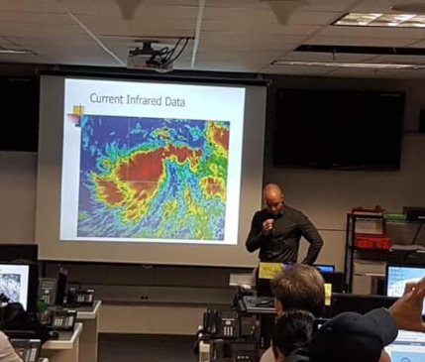
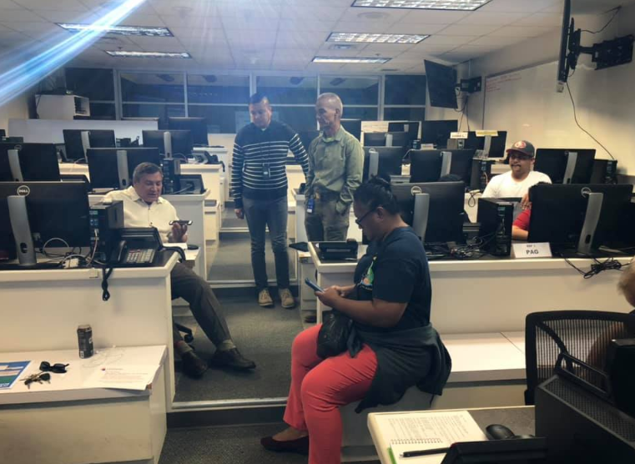
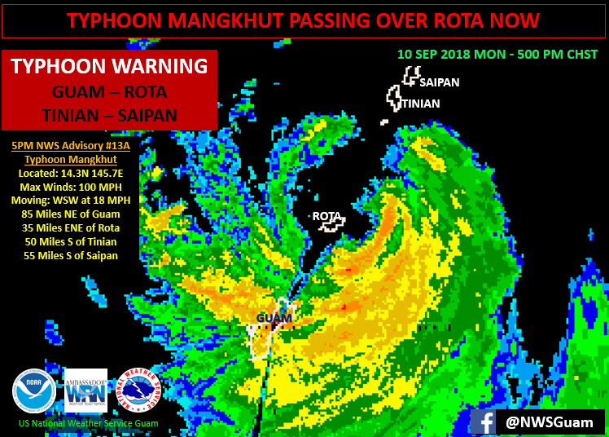
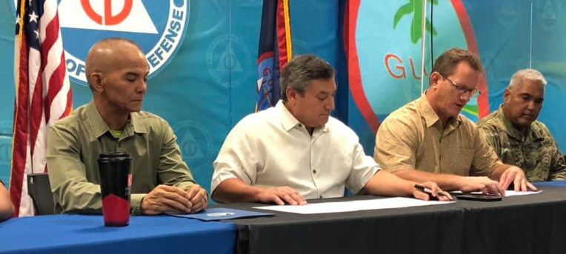
Impact-Based Decision Support Service (IDSS)
Operational IDSS: Heavy Weather Briefs
TYPHOON MANGKHUT
HEAVY WEATHER BRIEF
Guam Homeland Security/
Office of Civil Defense
September 2018
IDSS AND THE U.S. NATIONAL WEATHER SERVICE

Slide 11
Assessing IDSS in the NWS
IDSS Surveys for Core Partners
Two surveys were created to examine: Accessibility, Consistency, Comprehension, Decision-Making, Timeliness, Service Quality and Trust
Episodic Surveys
Assesses event-driven IDSS; the provision of information and interpretive services to support an event or incident where weather, water or climate has a direct impact on the protection of lives/livelihoods
Annual (Routine) Surveys
Serves as an end-of-year assessment of IDSS that occurred throughout the year. Survey includes joint training, Integrated Warning Team interactions, pre-event/scenario planning, forecasts and planning, table-top exercises and daily coordination regarding high value decisions
IDSS AND THE U.S. NATIONAL WEATHER SERVICE

Slide 12
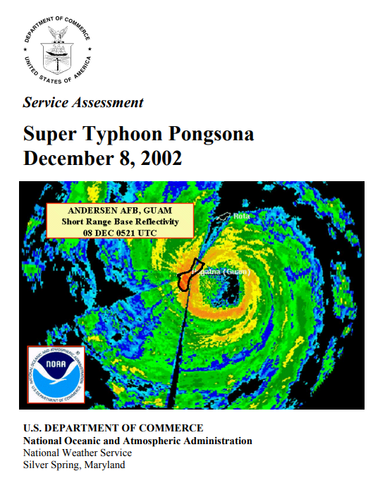
Assessing IDSS in the NWS
Service Assessments
The NWS conducts Service Assessments to evaluate its performance after significant hydrometeorological, oceanographic, or geological events. Assessments may be initiated when one or more of the following criteria are met:
Major economic impact on a large area or population
Multiple fatalities or numerous serious injuries
Extensive national public interest or media coverage
Unusual level of attention to NWS performance
Teams composed of experts within and outside of the NWS evaluate activities before, during and after events to determine usefulness of NWS products and services to identify best practices and any service deficiencies, with a goal to continuously improve its service to the nation
IDSS AND THE U.S. NATIONAL WEATHER SERVICE

Slide 13
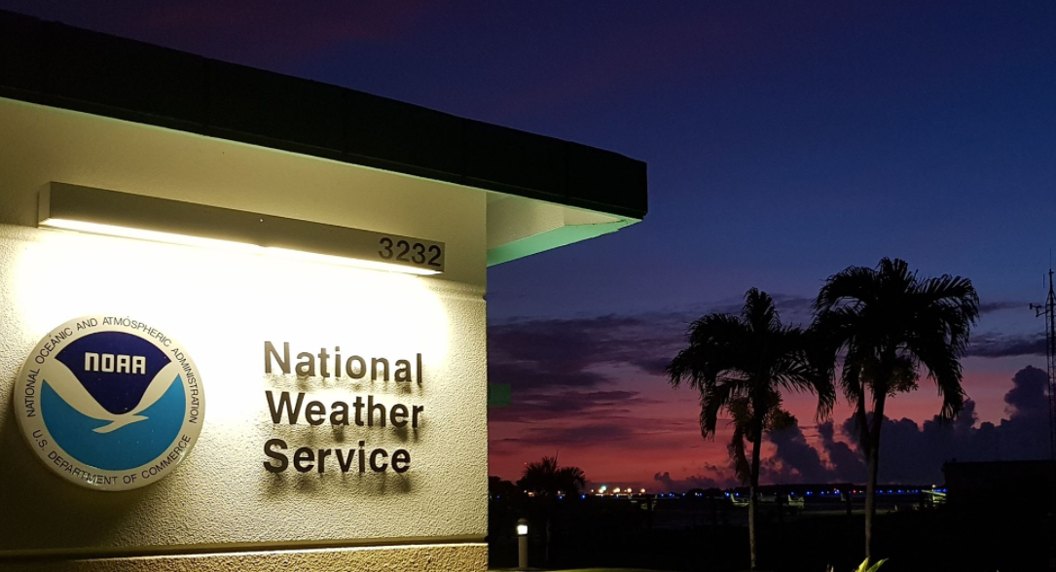
ESCAP / WMO TYPHOON COMMITTEE 16TH INTEGRATED WORKSHOP
VIRTUAL DECEMBER 2 – 3, 2021
FOR MORE INFORMATION ON TOPICS DISCUSSED IN THIS PRESENTATION:
Marcus Landon Aydlett
Warning Coordination Meteorologist
US National Weather Service, Guam
Marcus.Aydlett@NOAA.gov
THANK YOU!
STRENGTHENING IMPACT-BASED FORECASTING FOR IMPROVING THE CAPACITY OF TYPHOON-RELATED DISASTER RISK REDUCTION

